Slide 1
Developing tool for detecting and counting unique people or characters in a movie clip.
Team Name - Pixel Pioneers
Team Members:
Mariyala Venkata Sai Mukhesh – 22b0972
Trasula Umesh Karthikeya – 22b0913
This work is done as part of IE 643 course project.

Slide 2
Table of contents:
Task allocated
Workflow
Summary before prep presentation
Description after prep presentation
Proposed approaches
Datasets
Experiments
Results
Conclusion
Novelty Assessment
References

Slide 3

Task allocated:
We need to check for available datasets and need to create a dataset using publicly available movie clips.
Develop a model which need to detect person in movie clip.
Assign unique ids to individual persons
Need to develop a performance metric to measure goodness of the model’s prediction
Need to count the unique persons in the movie clip

Slide 4
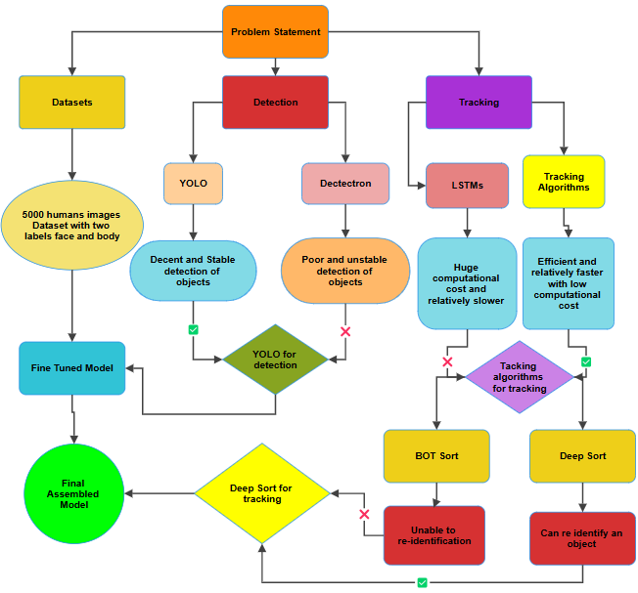
Workflow

Slide 5
Summary Of Work before the prep presentation
Compared the detection performance of Detectron and YOLO
Selected YOLO as the final detection model
Unable to track unique IDs for individual persons in video sequences
Researched a few papers for tracking object in a video
Considered integrating YOLO with LSTM for object tracking purposes
Defined quantitative metrics for evaluation
Utilized a basic dataset without occlusions or complex poses
Planned to create an interface using Flask, Python, HTML, and JavaScript
Couldn’t assign re-ID for the same person if a person appears and disappears then re-appears again

Slide 6
Description of work done after prep presentation
Achieved stable bounding box detection for persons in videos
Successfully assigned and tracked unique IDs for individuals in video sequences
Updated measurement metrics to prevent negative values
Decided to use gradio instead of Flask, Python, HTML, and JavaScript for the interface.
Fine-tuned the initial YOLOv11 model using a more complex dataset with 5,822 images for bothtraining and testing
Implemented tracking algorithms such as DEEP SORT and BOT SORT, replacing LSTM for im-proved efficiency and accuracy
Developed the interface and integrated the fine-tuned YOLOv11 model with DEEP SORT to complete the final pipeline

Slide 7
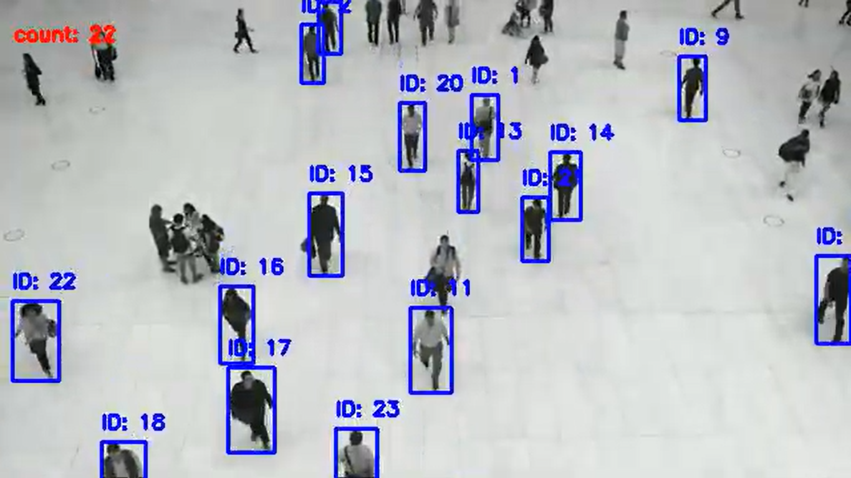
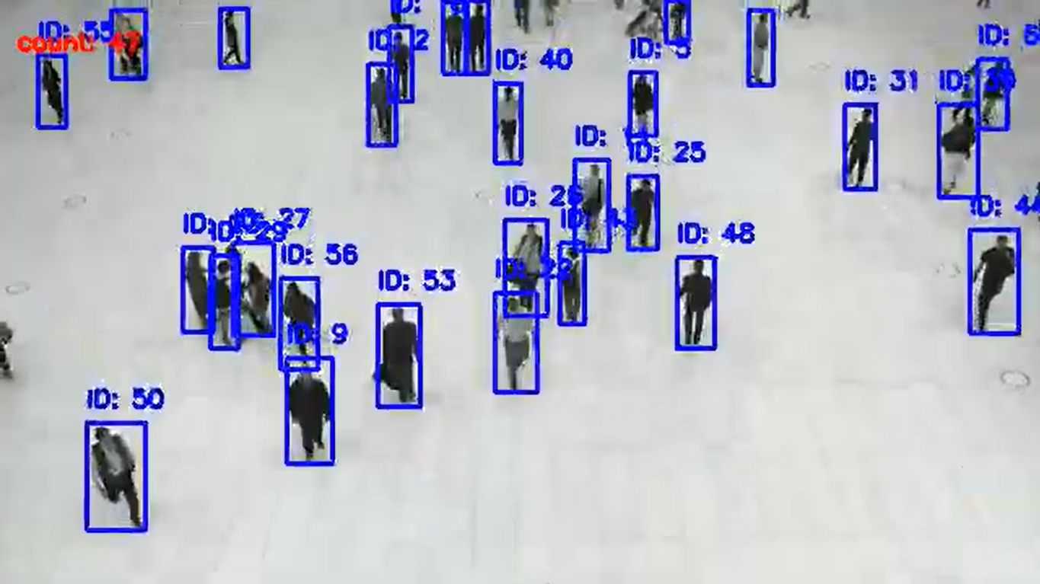
Proposed approach or approaches
Human Detection:
Compared performance of YOLO and Detectron2
Used YOLO v11 pre-trained model
Fine tuned with an image dataset of humans
After fine tuning could detect the cases of occlusions
After fine tuning
Before fine tuning

Slide 8
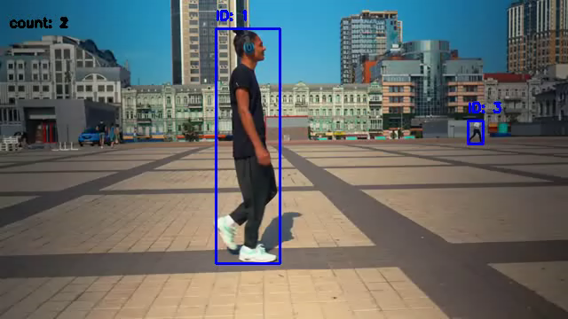
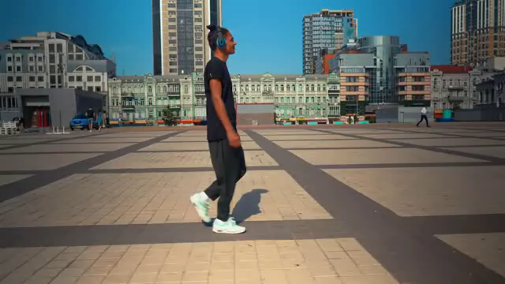
Proposed approach or approaches
Human Tracking:
Avoided LSTM approach due to its computational cost
Used tracking algorithms like DEEP SORT, BOT SORT
DEEP SORT can also handle case of RE-ID
These are faster and efficient than LSTM
BOT SORT
Deep SORT

Slide 9
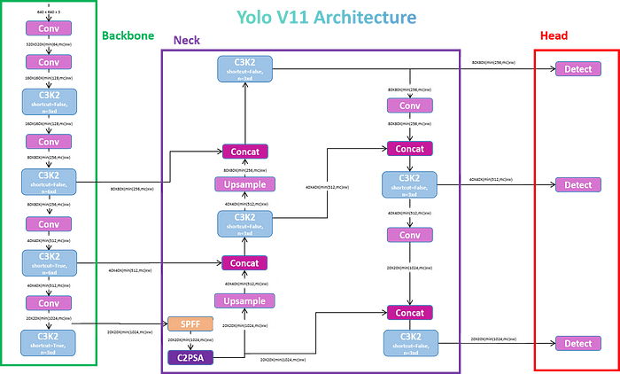
Proposed approach or approaches
YOLO v11 Architecture:
It mainly contains three fundamental components backbone, neck and head
Backbone acts as the primary feature extractor, utilizing convolutional neural networks to transform raw image data into multi-scale feature maps
The neck component acts as an intermediate processing stage, employing specialized layers to aggre-gate and enhance feature representation
The head is designed to adaptively adjust to image complexity, utilizing a multi-scale detection strategy
It uses C3k2 blocks for faster processing and parameter efficiency
he Cross Stage Partial with Spatial Attention (C2PSA) block improve accuracy, C3k2 block reduce complexity making perfect choice for our project

Slide 10
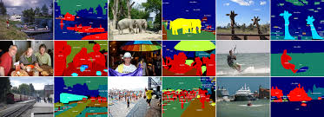
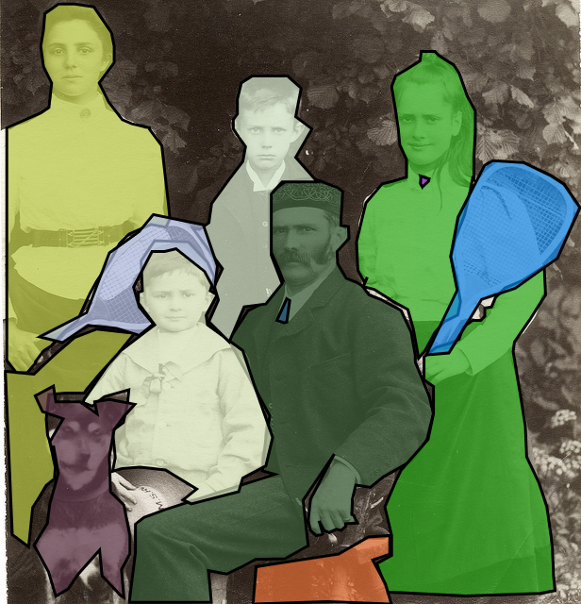
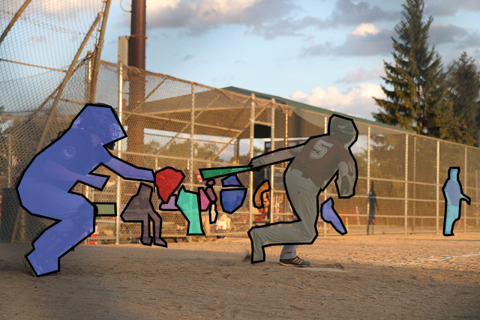
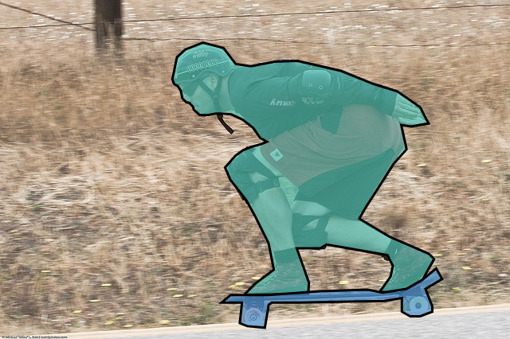
Datasets - COCO Dataset
YOLO was trained on COCO Dataset
COCO (Common Object in Context)
Size – 123,387 images with 80 object categories and 886,284 object instances
Has bounding boxes annotations for object detection, segmented masks for image segmentation tasks
It has images where it contains wide range of object sizes, occlusions, and lighting conditions

Slide 11
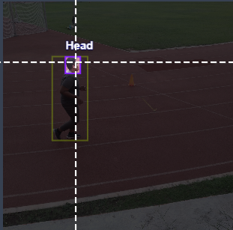
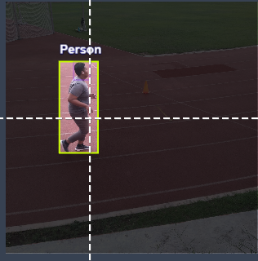
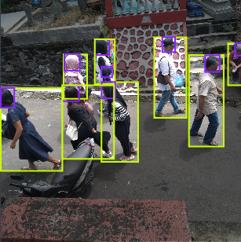
Datasets - Custom Dataset
We fine tuned YOLO v11 model on a custom image dataset
It can be accessed here
Size – 5,822 images with 2 classes one for head other for person
Has bounding boxes annotations for object detection
It has images where it contains wide range of object sizes, occlusions, and lighting conditions
Since it mainly concentrates on humans it is highly useful for us

Slide 12
Experiments
We fine-tuned the YOLOV11 model to detect the persons better.
This is the process of the fine-tuning we followed :-
Collected a custom Dataset containing only people
We fixed the weights of all the layers except the last layer.
We Updated the weights of the last layer by training the model using the custom Dataset.
We compared Bot-sort and Deep-sort for tracking the detected persons.
We tested Bot-sort and Deep-sort on various types of videos like
Normal/General videos
Videos which include occlusions.
Videos where a person disappears and appears in the video after some time.

Slide 13
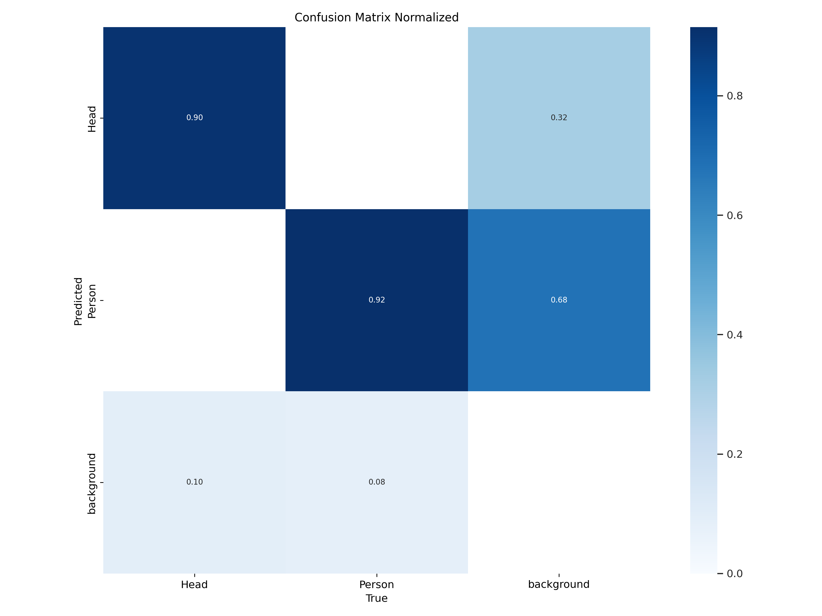
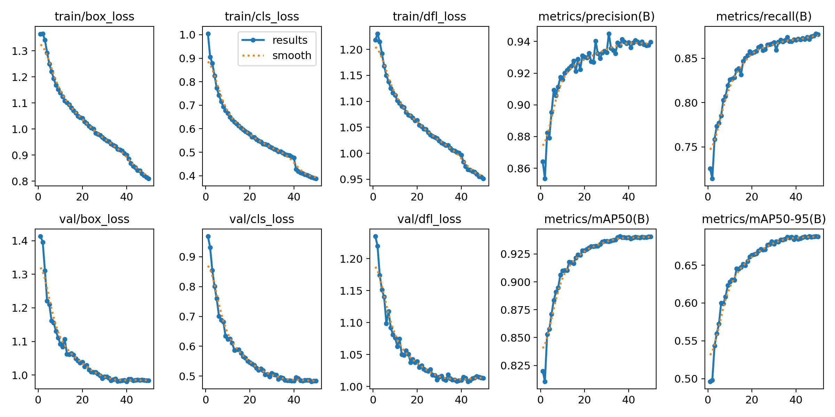
Results
Let's examine the results of fine-tuning.
After fine-tuning in the graphs we can see that loss for validation set is continiously decreasing and the map value is increasing
After fine-tuning we can also see in the confusion matrix the accuracy for detecting persons is 92 % accuracy.

Slide 14
Results
Results
Let's examine the results of fine-tuning.
Before fine-tuning
After fine-tuning
You can clearly see before fine-tuning many persons were not detected like the persons in the group while they were successfully detected by the model after fine-tuning.

Slide 15
Results
Results
Let's examine the results of Deep-sort vs Bot-sort .
For Normal/General Models both trackers are doing a very good job.
For Occlusions Deep-Sort is doing a better job compared to Bot-sort.
Deep-Sort
Bot-Sort
As we can clearly see in the bot sort video when a person entered he gets an ID that is already assigned to other person, but this is not the case in deep-sort Where the new person gets a new id and even when he gets occluded by other person his ID remains same.

Slide 16

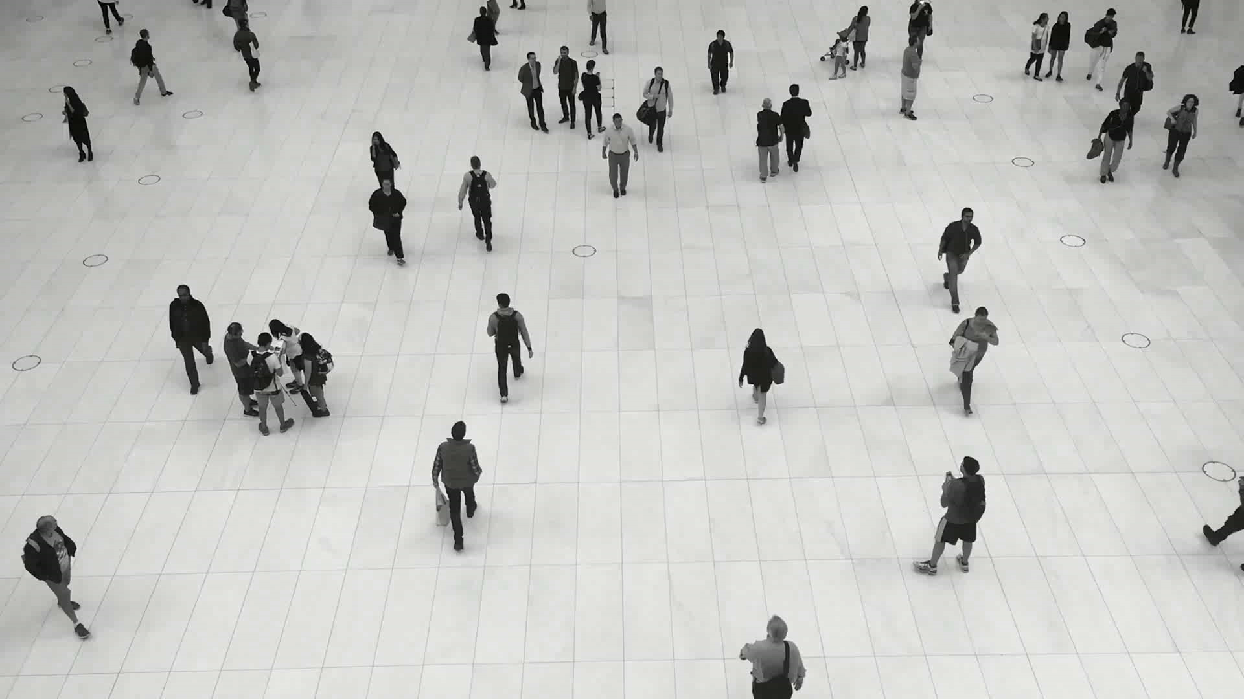
Results
Let's examine the results in the cases where a person goes out of the frame and then enters after some time.
In these cases Deep-sort is very helpful as it can be easily integrated with re-identification model.
But there is a trad-off included with the max_age parameter.
If max_age is more re-identification works properly but we get some unnecessary tracks.
Clearly in the left side Video the ID of the person remains same even when he goes out and enters as max_age is set to 200 and it fails in case of 50.
In the right side video it has unnecessary boxes as max_age is set to a high value but if it is set as 50 it doesn't give those boxes.
SO this is the tradeoff.

Slide 17
Conclusion
We divided the whole problem statement into two parts detection and tracking
For detection we tried two pre-trained models Detectron and YOLO
Decided to use YOLO due to it’s high accuracy and efficiency
We didn’t use LSTM for tracking objects due to high computational cost
We used tracking algorithms like BOT SORT and DEEP SORT to track objects in a video since it is computationally more efficient and accurate
Using DEEP SORT we can also handle the case of re identification of a person i.e, if the same person appears, disappears and then re-appears in the video
Still we are left with some challenges like Wrong predictions by Deep sort due to rapid movement in camera When there is rapid movement the kalman filter is giving the predictions of a track wrongly as it is considering the speed of the camera
Head detection vs body detection in some cases head detection works good in other cases body detection works well, we couldn’t automate this part.

Slide 18
Novelty Assessment
For the novelty assessment part we are currently planning to do the following tasks
To display the path travelled by the person or character in the video
To detect the action performed by the person or character in the video
Still we didn’t explore much into this part, we might change this if the task we are currently proposing is hard to implement
Since both the above tasks require tracking in between the frames which we are currently doing, hence we are assuming that this is possible to do

Slide 19
References
[1] Minghai Chen, Guiguang Ding, Sicheng Zhao, Hui Chen, Jungong Han, and Qiang Liu. Reference based lstm for image captioning. 2017.
[2] M. Everingham and A. Zisserman. Identifying individuals in video by combining ’generative’ and discriminative head models. 2005.
[3] Rahima Khanam and Muhammad Hussain. Yolov11: An overview of the key architectural enhancements. 2024.
[4] Jingwen Li, Lei Huang, and Changping Liu. Tracking of humans in video stream using lstm recurrent neural network. 2011.
[5] Jingwen Li, Lei Huang, and Changping Liu. Online adaptive learning for multi-camera people counting. 2012.
[6] Jingwen Li, Lei Huang, and Changping Liu. People counting across multiple cameras for intelligent video surveillance. 2012.
[7] Masoumeh Poormehdi Ghaemmoghami. Tracking of humans in video stream using lstm recurrent neural network. 2017.
[8] Joseph Redmon, Santosh Divvala, Ross Girshick, and Ali Farhadi. You only look once: Unified, real-time object detection. 2015.
[9] Li Tan, Xu Dong, Yuxi Ma, and Chongchong Yu. A multiple object tracking algorithm based on yolo detection. 2018.

Slide 20
Thank You for your time
Team Name - Pixel Pioneers
Team Members:
Mariyala Venkata Sai Mukhesh – 22b0972
Trasula Umesh Karthikeya – 22b0913
This work is done as part of IE 643 course project.

